Slide 1
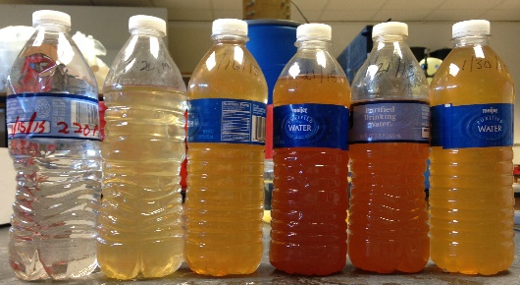
Flint resident sampling: August 2015 vs. March 2016
Kelsey Pieper and Marc Edwards
Virginia Tech

Slide 2
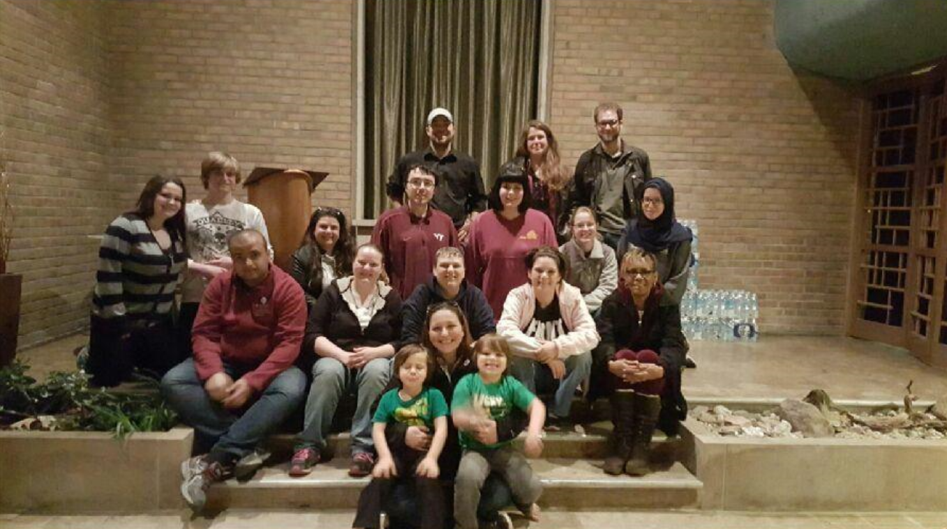
Flint residents
Dennis Walters, Matt Smith, Tracy Hacker, Tonya Williams, Kaylie Mosteller, Carrie Nelson, Claire McClinton, Keri Webber, Tony Palladeno Jr., Leah Palladeno, Jessica Owens

Slide 3
Formation of scale within the distribution system
Lead-bearing
plumbing materials
Corrosion control
chemicals
Pb²⁺
PO₄⁻
Pb²⁺
Pb²⁺
PO₄⁻
Flowing water
PO₄⁻
PO₄⁻
Pb²⁺
Pb²⁺

Slide 4
Formation of scale within the distribution system
Formation of protective scale
layer: requires flowing water
Flowing water

Slide 5
Water from Flint River disrupted developed scales and biofilms
Flushing at low flow will clean lead
deposits very slowly: Maybe months to years
Loose lead and iron sediment in pipes

Slide 6
Water from Flint River disrupted developed scales and biofilms
Flush pipes clean:
Remove lead and iron deposits in weeks
Flowing water

Slide 7
Promote biofilm (bacteria) control
Chlorine disinfection can treat water
OCl⁻
OCl⁻
OCl⁻
Flowing water
OCl⁻
OCl⁻

Slide 8
Comparing water quality in August 2015 vs. March 2016
To assess improvements since switch back to Detroit water and implementation of improved corrosion control

Slide 9
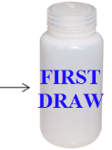
Sampling protocol
Collected water samples from a cold water tap that is used for drinking water
6+ hour stagnation
Flush for
45 seconds
Flush for
2 minutes
1 L
First draw (FD)
500 mL
~1 min flush
250 mL
~3 min flush

Slide 10
Homeowner sampling in Flint
August 2015: 269 homes sampled
Participation rate: 90%
March 2016: 187 homes sampled
Participation rate: 70%
174 homes participating
in both 2015 and 2016
used for analysis

Slide 11
174 households participated in both 2015 and 2016
 | Non detects | Average | Median | 90th | Max | % >AL
2015
FD | 10% | 12.2 | 4.4 | 29.0 | 158 | 19%
1 min | 37% | 11.1 | 2.2 | 11.9 | 1,051 | 6%
3 min | 49% | 3.8 | 1.0 | 7.6 | 95 | 3%
2016
FD | 38% | 32.3 | 1.8 | 23.0 | 2,253 | 15%
1 min | 58% | 3.6 | 0.5 | 9.0 | 81 | 5%
3 min | 71% | 1.9 | 0.5 | 3.4 | 69 | 2%

Slide 12
174 households participated in both 2015 and 2016
 | Non detects | Average | Median | 90th | Max | % >AL
2015
FD | 10% | 12.2 | 4.4 | 29.0 | 158 | 19%
1 min | 37% | 11.1 | 2.2 | 11.9 | 1,051 | 6%
3 min | 49% | 3.8 | 1.0 | 7.6 | 95 | 3%
2016
FD | 38% | 32.3 | 1.8 | 23.0 | 2,253 | 15%
1 min | 58% | 3.6 | 0.5 | 9.0 | 81 | 5%
3 min | 71% | 1.9 | 0.5 | 3.4 | 69 | 2%

Slide 13
174 households participated in both 2015 and 2016
 | Non detects | Average | Median | 90th | Max | % >AL
2015
FD | 10% | 12.2 | 4.4 | 29.0 | 158 | 19%
1 min | 37% | 11.1 | 2.2 | 11.9 | 1,051 | 6%
3 min | 49% | 3.8 | 1.0 | 7.6 | 95 | 3%
2016
FD | 38% | 32.3 | 1.8 | 23.0 | 2,253 | 15%
1 min | 58% | 3.6 | 0.5 | 9.0 | 81 | 5%
3 min | 71% | 1.9 | 0.5 | 3.4 | 69 | 2%

Slide 14
174 households participated in both 2015 and 2016
 | Non detects | Average | Median | 90th | Max | % >AL
2015
FD | 10% | 12.2 | 4.4 | 29.0 | 158 | 19%
1 min | 37% | 11.1 | 2.2 | 11.9 | 1,051 | 6%
3 min | 49% | 3.8 | 1.0 | 7.6 | 95 | 3%
2016
FD | 38% | 32.3 | 1.8 | 23.0 | 2,253 | 15%
1 min | 58% | 3.6 | 0.5 | 9.0 | 81 | 5%
3 min | 71% | 1.9 | 0.5 | 3.4 | 69 | 2%

Slide 15
174 households participated in both 2015 and 2016
 | Non detects | Average | Median | 90th | Max | % >AL
2015
FD | 10% | 12.2 | 4.4 | 29.0 | 158 | 19%
1 min | 37% | 11.1 | 2.2 | 11.9 | 1,051 | 6%
3 min | 49% | 3.8 | 1.0 | 7.6 | 95 | 3%
2016
FD | 38% | 32.3 | 1.8 | 23.0 | 2,253 | 15%
1 min | 58% | 3.6 | 0.5 | 9.0 | 81 | 5%
3 min | 71% | 1.9 | 0.5 | 3.4 | 69 | 2%

Slide 16
174 households participated in both 2015 and 2016
 | Non detects | Average | Median | 90th | Max | % >AL
2015
FD | 10% | 12.2 | 4.4 | 29.0 | 158 | 19%
1 min | 37% | 11.1 | 2.2 | 11.9 | 1,051 | 6%
3 min | 49% | 3.8 | 1.0 | 7.6 | 95 | 3%
2016
FD | 38% | 32.3 | 1.8 | 23.0 | 2,253 | 15%
1 min | 58% | 3.6 | 0.5 | 9.0 | 81 | 5%
3 min | 71% | 1.9 | 0.5 | 3.4 | 69 | 2%

Slide 17
2015 vs. 2016 first draws
15 ppb
10% >15 ppb in 2016 only
5% >15 ppb in both years
1:1 line
15 ppb
71% <15 ppb in both years
14% >15 ppb in 2015 only
Notes:
Correlation

Slide 18
2015 vs. 2016 first draws
No relationship between
lead levels by year
Recommending lead filters
17 ppb in 2015
2253 ppb in 2016
106 ppb in 2015
8 ppb in 2016
Notes:
Correlation

Slide 19
Iron in water concentrations
 | Average | Median | 90th | Max | %>SMCL
2015
FD | 305.6 | 125.7 | 349.4 | 9,195 | 13%
1 min | 162.5 | 111.2 | 285.4 | 2,323 | 9%
3 min | 148.5 | 119.5 | 247.8 | 1,627 | 7%
2016
FD | 292.7 | 53.7 | 418.4 | 13,820 | 14%
1 min | 92.9 | 36.3 | 157.2 | 1,471 | 5%
3 min | 83.0 | 40.5 | 160.6 | 1,572 | 4%

Slide 20
Iron in water concentrations
 | Average | Median | 90th | Max | %>SMCL
2015
FD | 305.6 | 125.7 | 349.4 | 9,195 | 13%
1 min | 162.5 | 111.2 | 285.4 | 2,323 | 9%
3 min | 148.5 | 119.5 | 247.8 | 1,627 | 7%
2016
FD | 292.7 | 53.7 | 418.4 | 13,820 | 14%
1 min | 92.9 | 36.3 | 157.2 | 1,471 | 5%
3 min | 83.0 | 40.5 | 160.6 | 1,572 | 4%

Slide 21
Iron in water concentrations
 | Average | Median | 90th | Max | %>SMCL
2015
FD | 305.6 | 125.7 | 349.4 | 9,195 | 13%
1 min | 162.5 | 111.2 | 285.4 | 2,323 | 9%
3 min | 148.5 | 119.5 | 247.8 | 1,627 | 7%
2016
FD | 292.7 | 53.7 | 418.4 | 13,820 | 14%
1 min | 92.9 | 36.3 | 157.2 | 1,471 | 5%
3 min | 83.0 | 40.5 | 160.6 | 1,572 | 4%

Slide 22
Phosphate levels in 2016
Detachment of leaded scale
Inadequate levels of corrosion control chemicals

Slide 23
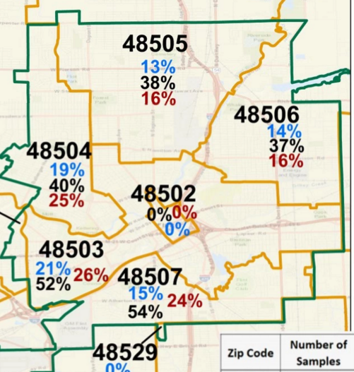
Change in lead levels by zip code
WTP
n=1

Slide 24
Many Flint residents are using very little water
Two homes with persistent elevated lead problem only using 20-45% of typical monthly volume
Trying to reduce water bills
Showering only once per week (<5 min) to reduce the likelihood of rashes or exposure
Using bottled water for baths, washing dishes and other uses

Slide 25
Conclusions
Flint is not yet meeting the 90%’ile lead action level
Lead levels are lower than in August 2015
Iron levels (and red water complaints) are decreasing
To speed up recovery of the system, residents will need to use more water

Slide 26
Virginia Tech Research Team
Undergraduate Students: Madeleine Brouse, Margaret Carolan, Sara Chergaoui, Matthew Dowdle, Kim Hughes, Rebecca Jones, Alison Vick
Graduate Students: Christina Devine, Emily Garner, Catherine Grey, Pan Ji, Anurag Mantha, Rebekah Martin, Jake Metch, Victoria Nystrom, Colin Richards, William Rhoads, Siddhartha Roy, Laurel Strom, Owen Strom, Min Tang, Ni Zhu
Post-docs/Research Scientists: Brandi Clark, Dongjuan Dai, Sheldon Masters, Jeffrey Parks, David Schwake, Fei Wang
Virginia Tech Staff: Cassandra Hockman
Principal Investigators: Amy Pruden and Joseph Falkinham III

Slide 27
Thank you!
Dennis Walters, Matt Smith, Tracy Hacker, Tonya Williams, Kaylie Mosteller, Carrie Nelson, Claire McClinton, Keri Webber, Tony Palladeno Jr., Leah Palladeno, Jessica Owens

